Slide 1

Welcome
SEND Information Meeting for Parents
Wednesday 1st October 2025

Slide 2
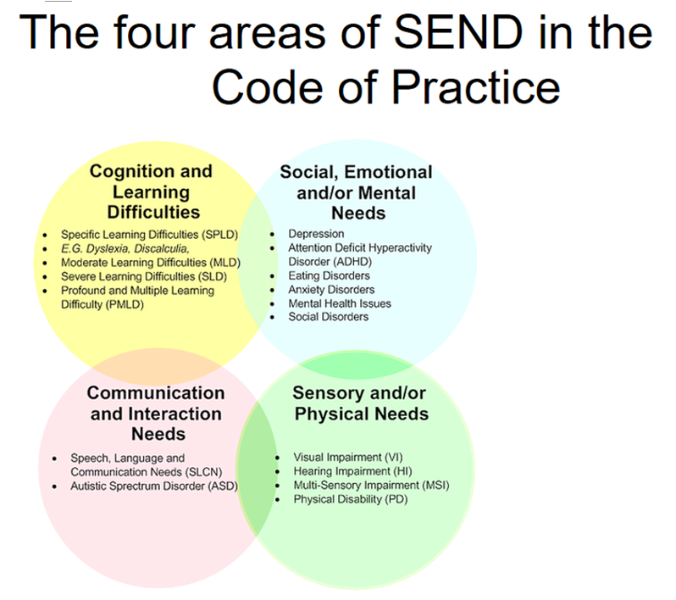

Slide 3
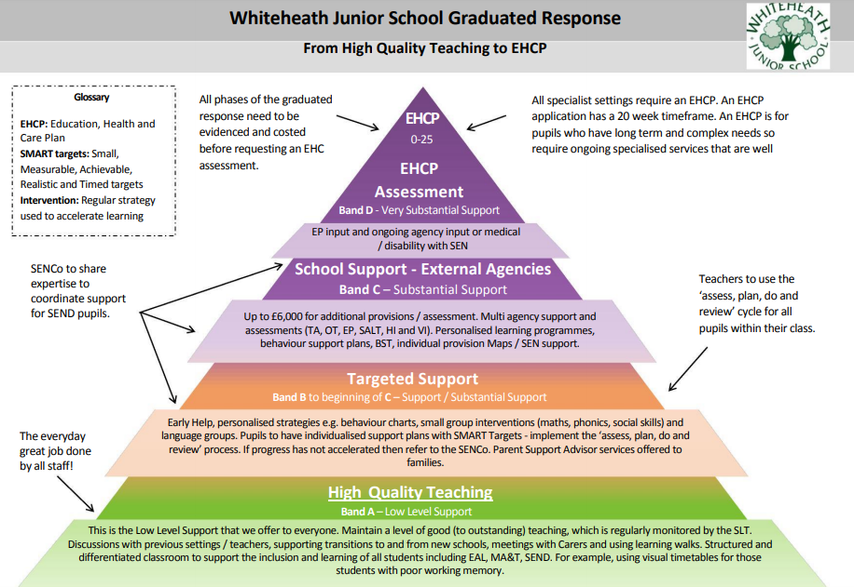

Slide 4
Quality First Teaching (QFT)/ High Quality Teaching (HQT):
High quality teaching which is differentiated or personalised for individual
pupils, is the first step in responding to pupils who have additional
learning needs.
Additional intervention and support cannot replace good quality teaching.

Slide 5
Quality First Teaching/ High Quality Teaching:
What does this look like at Whiteheath?
- Knowledge and skills based learning
- Appropriate resources to support different learning styles
- Planning for the needs of our children and differentiation of tasks
- Clear learning intentions and success criteria
- Visual cues and timetables
- Checking the understanding of our children throughout the lesson – AFL
- Modelling and demonstrating
- Group, paired and individual tasks
- Use of task boards and time specific activities
- Immediate feedback and praise/ Same Day Interventions
- Effective use of support staff
- Precision Teaching
- Specific interventions – universal and targeted
- Interactive teaching styles
- Maximum use of visual and kinaesthetic as well as auditory/verbal learning (multi-sensory)
- Working with specialists, such as a SaLT, to ensure lessons are inclusive and meet the different needs of the children

Slide 6
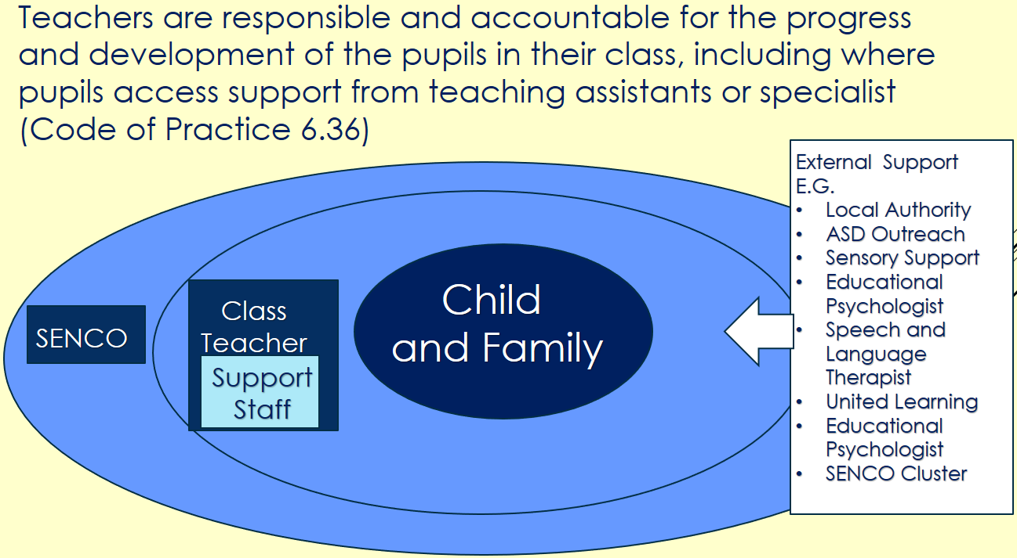

Slide 7
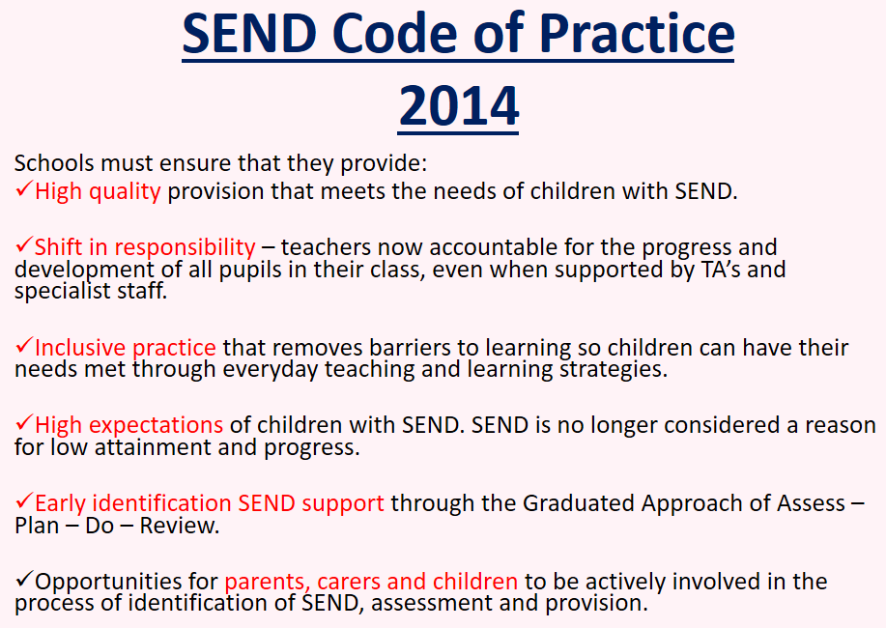

Slide 8
Assess, Plan, Do and Review:
  Assess –Each child and their individual needs (in particular areas)
  Plan - What is the most appropriate support or intervention? What has worked well before for this child? What has worked well for others?
  Do – The intervention.
  Review - How successful has this been? Should it continue? What else should/could we do?
SEN support is for
any child whose attainment is significantly behind age related expectations
or for whom academic progress and attainment are dependent upon significant intervention which is different from and additional to their peer group.
This includes those children with short term medical or emotional needs.

Slide 9
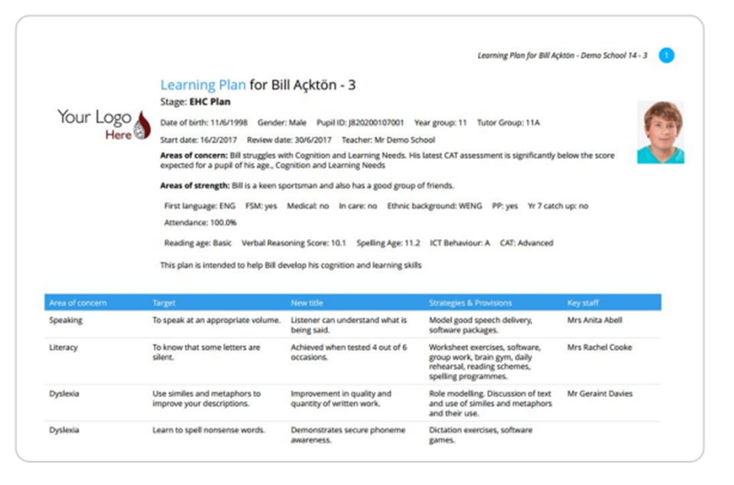
Example Learning Plan (from Edukey Training Materials)

Slide 10
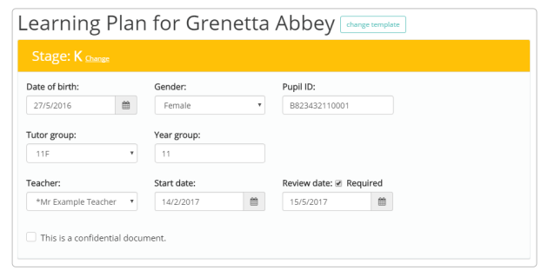

Slide 11
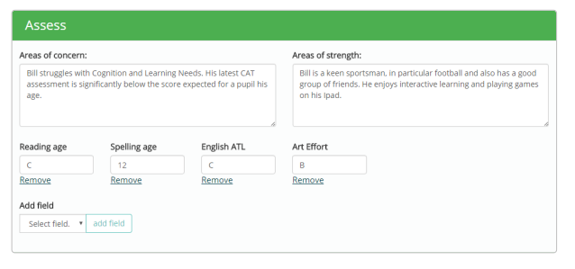

Slide 12
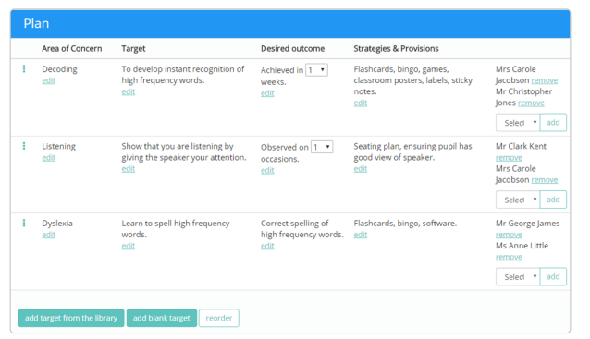

Slide 13
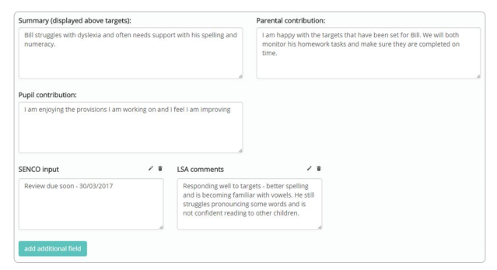

Slide 14
Further information:
Our SEND Provision Information Report can be found in the ‘key information’ section of the school website.
Information about the SEND Local Offer is available on the Hillingdon Borough website – link available in the ‘key information’ section of the website and on the information cards (please take one).
There are additional activities and ideas under ‘Curriculum – Supporting Children with SEND’ on the school website.
You can contact your child’s class teacher, or the SENDCo, if you have any questions about provision for your child or their progress.
Hillingdon SENDIASS is a free, confidential and impartial support service for parents and carers, children and young people up to 25 years where the child or young person may have special educational needs.
www.hillingdonsendiass.co.uk

Slide 15
Your feedback is important.
Parent Questionnaires will be sent out to parents/ carers of children with SEND.
Please return these by 31st October.
Any Questions?
What would you like our SEND/Pastoral sessions to include?

